Slide 1


DEFINE BIG
💎
Premium License
Large datasets in the service don't affect the Power BI Desktop model upload size, which is still limited to 10 GB.
Keeping within Bounds
Consider loading a proportion of data in terms of
Dimensions Facts
Be mindful of query folding and its impact on data refresh (only works with data sources that support query folding. Moving away from Csvs is a good idea.
Follow data type conversion best practices (Why we should always use the Fixed Decimal data type (facet) for numeric values when possible: Chapter 2)
Optimize query size
Use query parameters
Define key columns in queries

Slide 2


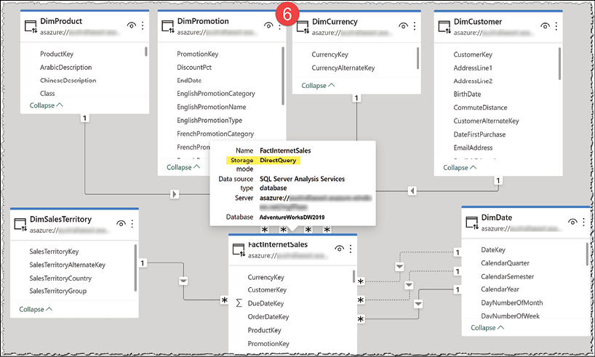
The PRESENT
For executive summaries we need the proverbial 10,000 feet view.
Define aggregation granularities.
We need one or more aggregations
For users to drill down to a lower grain, we must keep the data in its lowest grain in the data model.
Use DirectQuery(DQ) for facts
Use composite models in Power BI Desktop - Power BI | Microsoft Learn

Slide 3

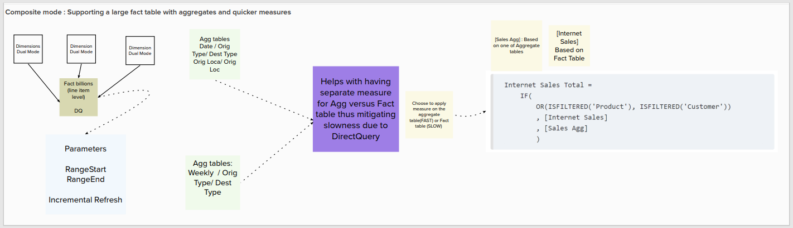
The PRESENT

Slide 4



The PRESENT
Dataflows usage scenarios
We more need to prepare data from large data sources at scale, and we own a Power BI Premium capacity
We do not have a data warehouse in the organization.
We want to reuse the curated data across the organization. ✔️
We need a self-service data preparation tool that does not require a lot of IT or development background. Indeed, Dataflows’ creators only need to have knowledge of Power Query. ❓⁉️
❌

Slide 5
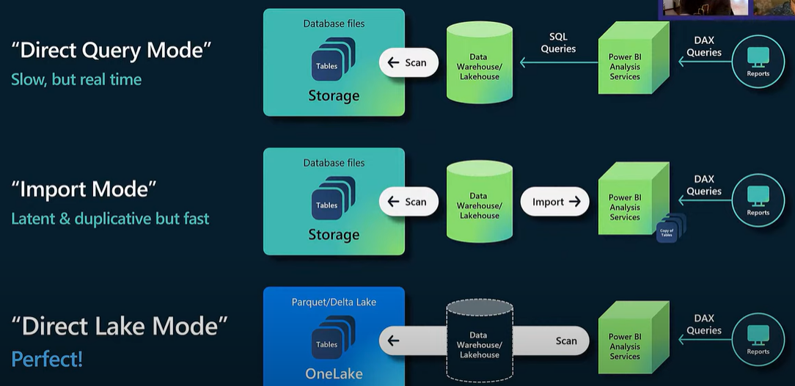
The FUTURE
Empower BI Professionals to Do More Using Microsoft Fabric (with Christian Wade) - YouTube

Slide 6
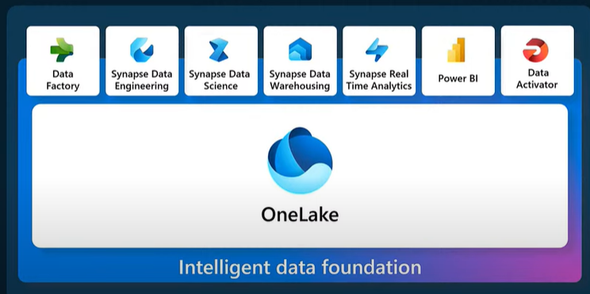
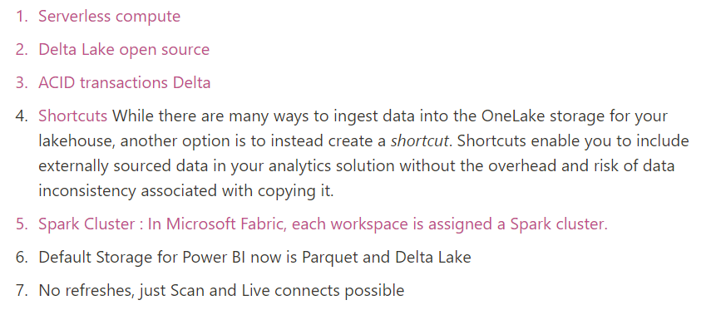
The FUTURE

Slide 7
*USE Explicit Measures
Optimize rows/Filter source data – Import only rows you need for your analysis. This will ensure that you only keep the required data in memory and therefore use it optimally. For example, you can set date filter to import only transactions for the last two years and not the entire sales history.
Optimize columns – Remove all columns that are not relevant to your analysis, such as primary keys not used in relationships, or columns that can be calculated from other columns, or description columns that are not needed.
Decrease granularity/ Group by and summarize – Detailed datasets have several rows of data, with information that is at a granular level. The more the granularity, the more rows of data you will have. So keep the datasets less granular and use grouping where possible to make the data more concise. For instance, if you are analysing monthly or yearly data, you could group your data on a monthly basis so that the granularity is reduced.
Optimize column data types – Reduce the cardinality for all columns stored in large tables, such as a fact table. To do this, round numbers to remove obsolete decimals; round time to remove milliseconds/seconds; separate text columns into two or more parts; split DateTime into date and time columns, etc. Also, avoid calculated columns since they consume memory. Make sure all columns have the correct data type.
Disable load – When you import data from a source, you apply transformations, such as merging and appending queries. As a result, you may end up with queries that are only used as intermediate transformation steps. By default, all queries from Query Editor are loaded into the memory of Power BI model. It is crucial to disable load for all queries that are not required in the final model.
Disable Auto Date/Time – Power BI automatically creates a built-in date table for each date field in the model to support time intelligence DAX functions. Those tables are hidden, they consume memory, and there is no flexibility to add custom columns. To remove all hidden date tables from your model, in Power BI Desktop select File / Options and Settings / Options / Data Load and untick the Auto Date/Time.
Transform data at the right place – Most data transformations generally take place in Query Editor in Power BI Desktop. Query Editor is a powerful and user-friendly tool that keeps track of all applied transformation steps which is useful for traceability and future maintenance. However, you may obtain improved performance when you apply transformations directly at the source database. For example, grouping your sales data by month in your transactional database will increase the source query execution times and as a result, only grouped data will be sent over the network to Power BI.

Slide 8
8. Consider using DirectQuery or a mixed model – You should import data to Power BI wherever possible, however, if your goals cannot be met by importing data, then consider using DirectQuery. In DirectQuery mode, you don’t have to import the data. You can get the data directly from the data source and so there are no limits on data volume on the Power BI side. However, report performance would be slower, and not all functionality would be available. So you can choose to have a mixed or composite model where you can store some of the tables in import mode and others in DirectQuery.
9. Move calculations to the backend – Think thoroughly about how you can move calculations on the back-end as much as possible For instance, creating new fields in the data source that allow you to reduce calculations effort of PBI

Slide 9
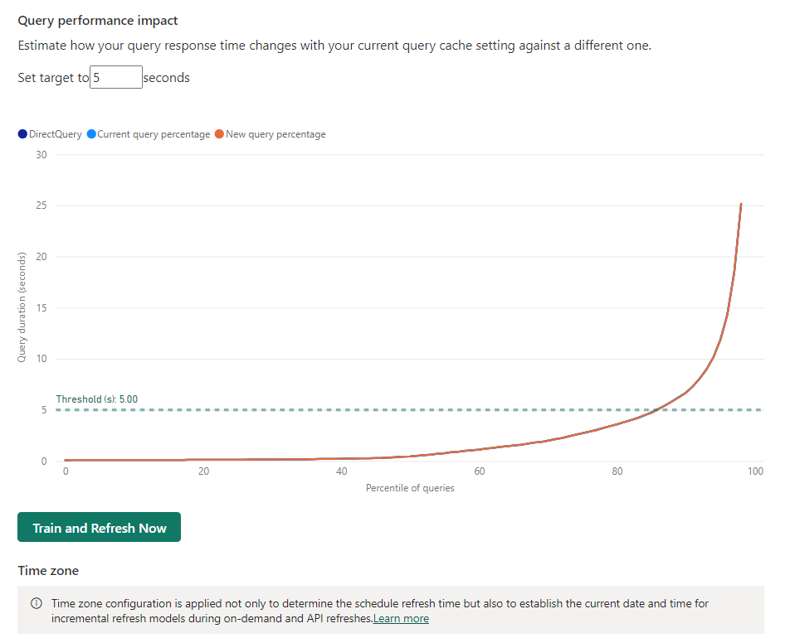
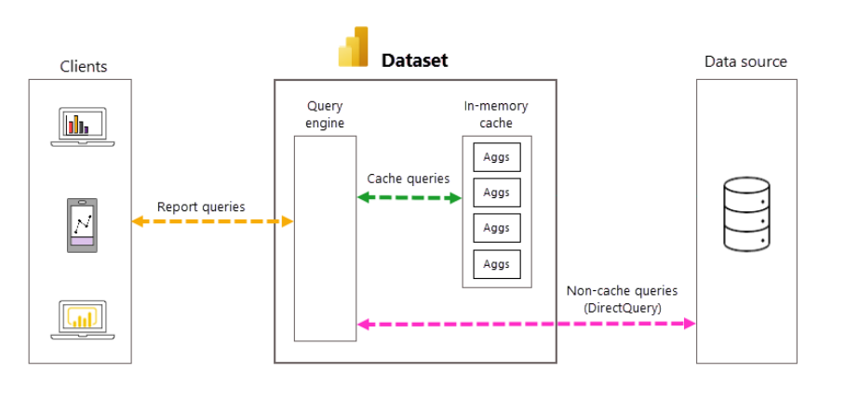
Automatic Aggregations with Machine Learning
https://learn.microsoft.com/en-us/power-bi/enterprise/aggregations-auto
Eliminate the need to create user-defined aggregation tables and dramatically simplify implementing a pre-aggregated data solution.

Slide 10
Automatic Aggregations with Machine Learning
he training algorithm creates and deletes only those System aggregations as reporting queries are analyzed and adjustments are made to maintain the optimal aggregations for the model.
https://learn.microsoft.com/en-us/power-bi/enterprise/aggregations-auto
. As client report query patterns change, automatic aggregations adjust, prioritizing and caching those aggregations used most often.
Because automatic aggregations are built on top of the existing user-defined aggregations infrastructure, it's possible to use both user-defined and automatic aggregations together in the same model.
he training algorithm creates and deletes only those System aggregations as reporting queries are analyzed and adjustments are made to maintain the optimal aggregations for the model.
Power BI doesn't support downloading models with automatic aggregations enabled. If you uploaded or published a Power BI Desktop (.pbix) file to Power BI and then enabled automatic aggregations, you can no longer download the PBIX file. Make sure you keep a copy of the PBIX file locally.
An optimal configuration strikes a balance between providing pre-aggregated results from the in-memory aggregations cache for the most frequently used report queries, while accepting slower results for outlier and ad-hoc queries in exchange for faster training and refresh times and a reduced burden on system resources.

